Slide 1
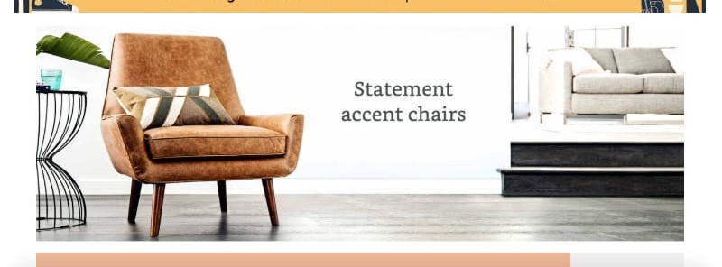
FurnTech Pvt Ltd Company Sales Report
2014-2017

Slide 2
Project Objective-Create an Interactive Dashboard for Company Sales
Hello Everyone,
I am excited to share my comprehensive analysis of Company Sales from the year 2014-2017
I worked on the raw company data and it was collected via a Youtube Channel ,I also named the company as Furntech Pvt Ltd for reference because the company deals in Furniture ,Office Supplies and Technology and there was some analysis the company wanted to understand which included the trend analysis of total sales, profit gained, customers etc
The problem statements I worked upon has been mentioned below:
Sales By Category
Profit Gained over Time
Sales by State
Customer Count
Top 5 customers making profit
Monthly sales
Skillset used:-
While creating the dashboard I went through the procedure of Data Cleaning,Data Processing ,Data Analysis,Data Visualization and Report Creation

Slide 3
The first 20 records as per the main table is shown below for reference:

Slide 4
The below is the reference pivot table attached for one of the reports for TOP 5 CUSTOMERS MAKING PROFIT

Slide 5
The below dashboard was prepared using Pivot Tables and Pivot Charts along with slicers for easy filtering (Slicers have been highlighted but not selected)

Slide 6
The key insights obtained from this project
Chairs are the ones which has been sold at maximum amounts
The most profitable year as per the data was in 2016 and the least profitable was in 2015
As per sales by state Alabama has scored the highest in terms of sales followed by Arizona and Arkansas
The customer count was at its peak in 2017 as per data provided
Top 5 customers making profit were Tamara Chand ,Raymond Buch, Sanjit Chand, Hunter Lopez, Adrian Barton
For the monthly sales we added the slicers to select and compare
Final Conclusion to improve FurnTech Pvt Ltd Company
Target the states with highest sales like Alabama(2014-2017) and provide them with some offers and some additional discounts, then the top 5 customers should be rewarded with some specialized hampers/gifts which will motivate them to purchase items in more quantities and will keep up the customer trust

